Slide 1
A road to nowhere?
Chris Todd
Campaign for Better Transport

Slide 2
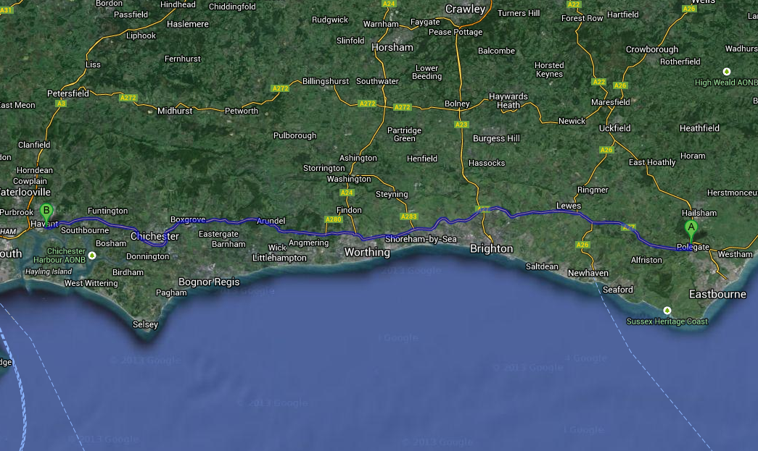
A27

Slide 3
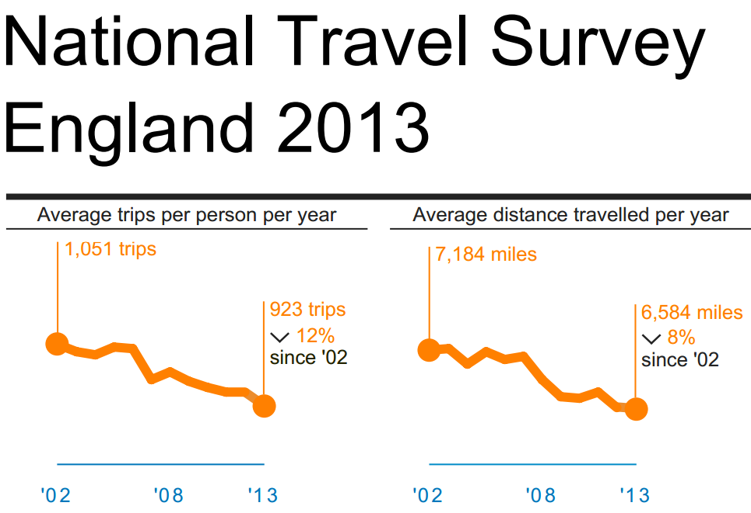

Slide 4
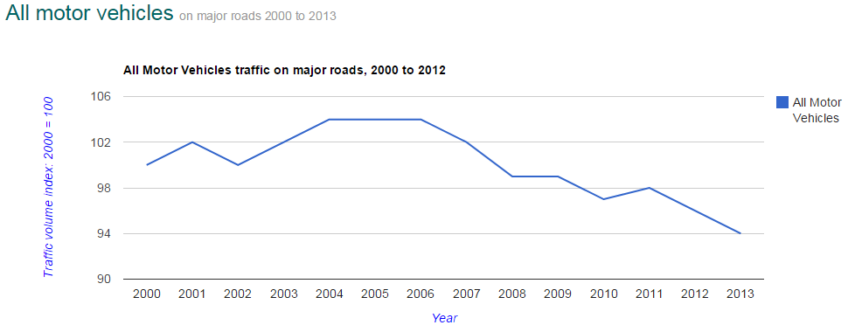
Traffic in West Sussex

Slide 5
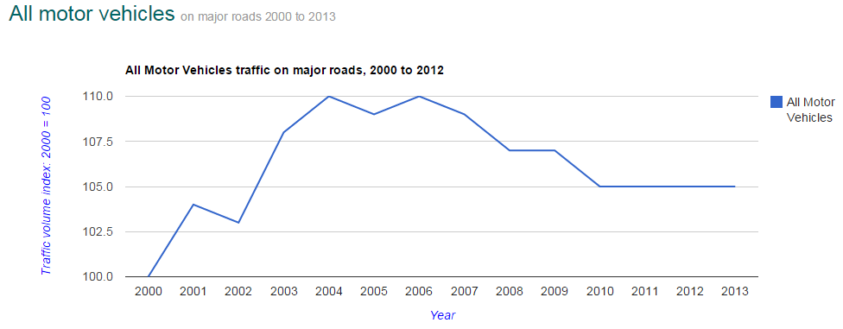
Traffic in East Sussex

Slide 6
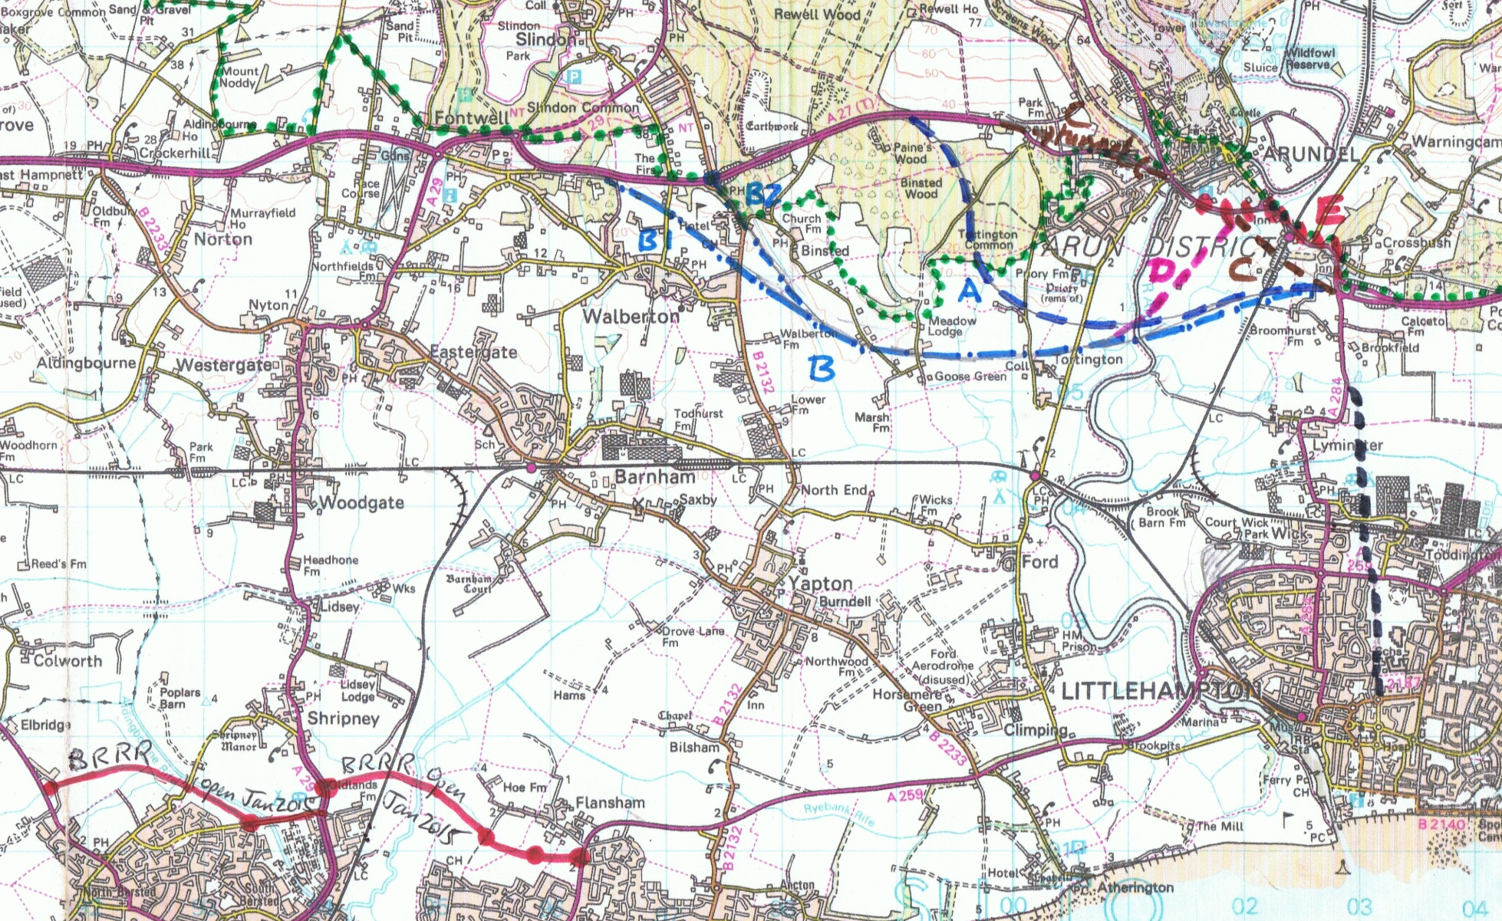
Arundel
Note: these lines are for illustration only and are not actual proposals as yet

Slide 7
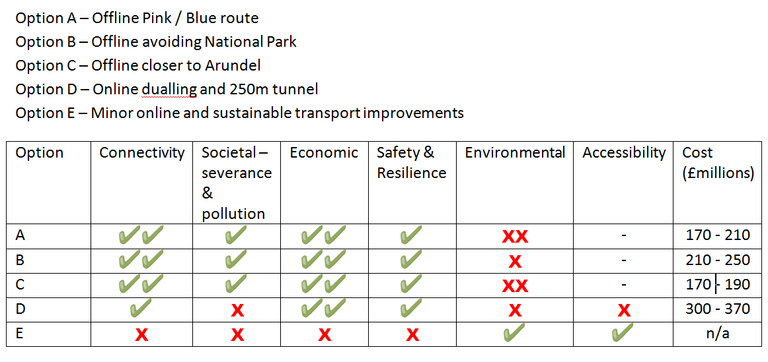
Arundel Scoring
Note: Department for Transport assessment as presented at the A27 Stakeholders Reference Group

Slide 8
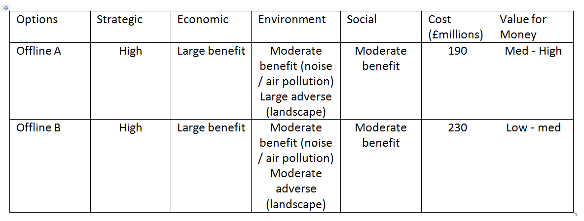
Arundel Priorities
Note: Department for Transport assessment as presented at the A27 Stakeholders Reference Group

Slide 9
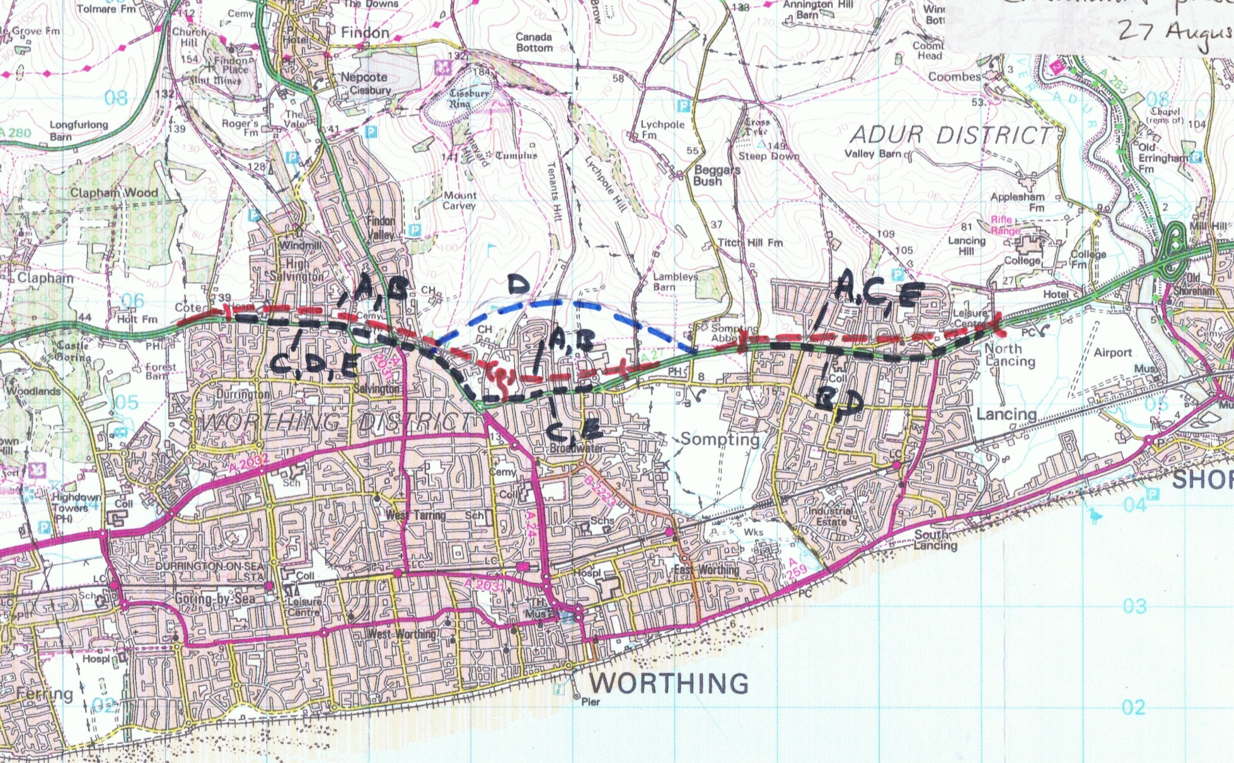
Worthing
Note: these lines are for illustration only and are not actual proposals as yet

Slide 10
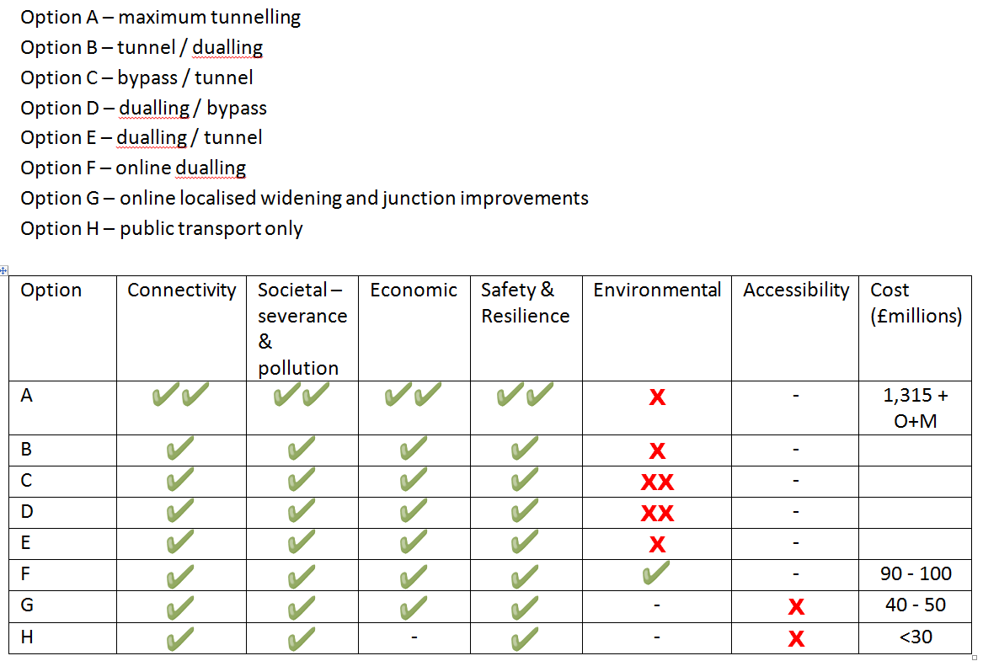
Worthing Scoring
Note: Department for Transport assessment as presented at the A27 Stakeholders Reference Group

Slide 11
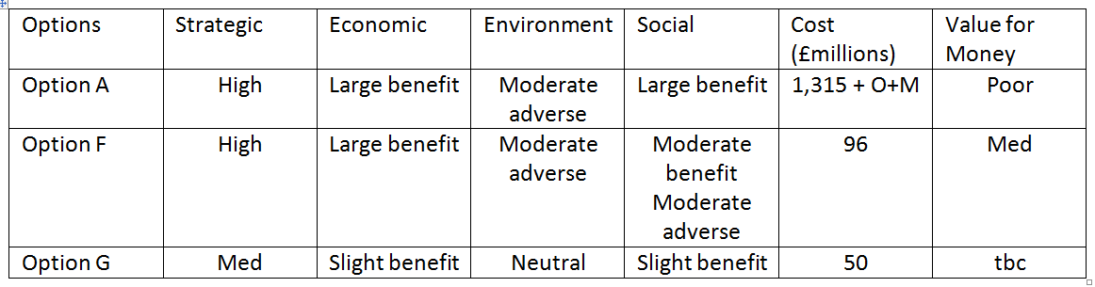
Worthing Priorities
Note: Department for Transport assessment as presented at the A27 Stakeholders Reference Group

Slide 12
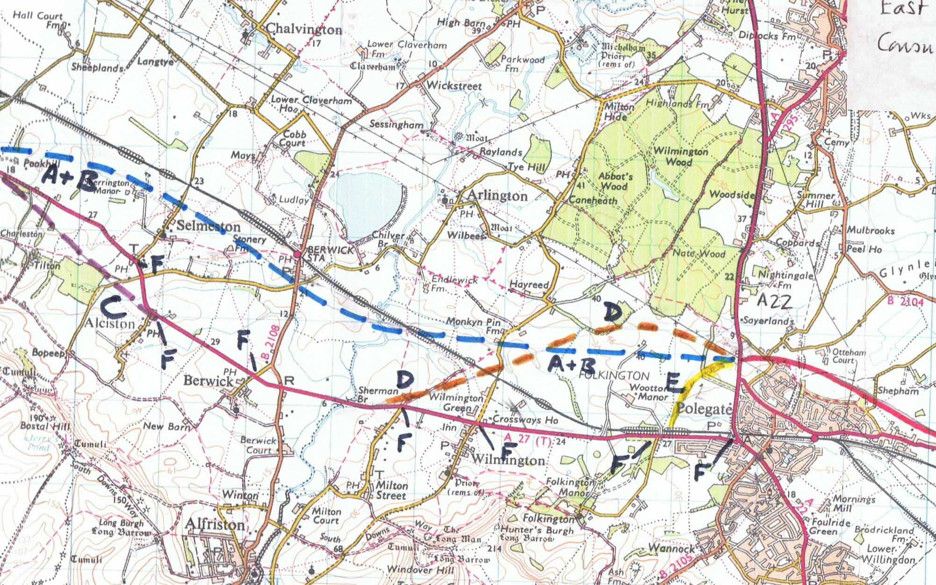
Lewes to Polegate
Note: these lines are for illustration only and are not actual proposals as yet

Slide 13
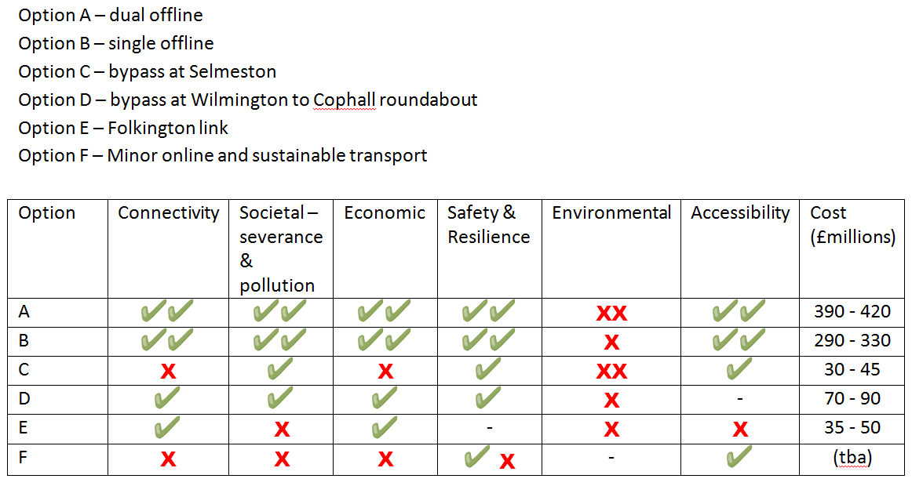
Lewes to Polegate Scoring
Note: Department for Transport assessment as presented at the A27 Stakeholders Reference Group

Slide 14
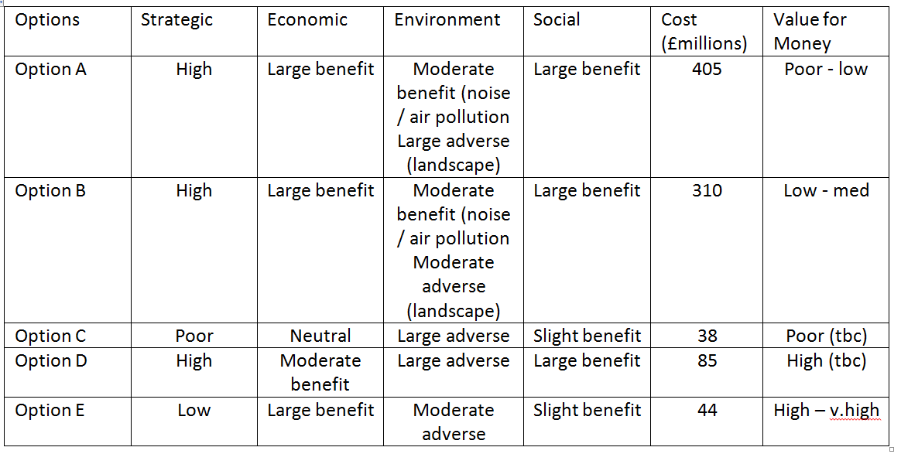
Lewes to Polegate Priorities
Note: Department for Transport assessment as presented at the A27 Stakeholders Reference Group

Slide 15
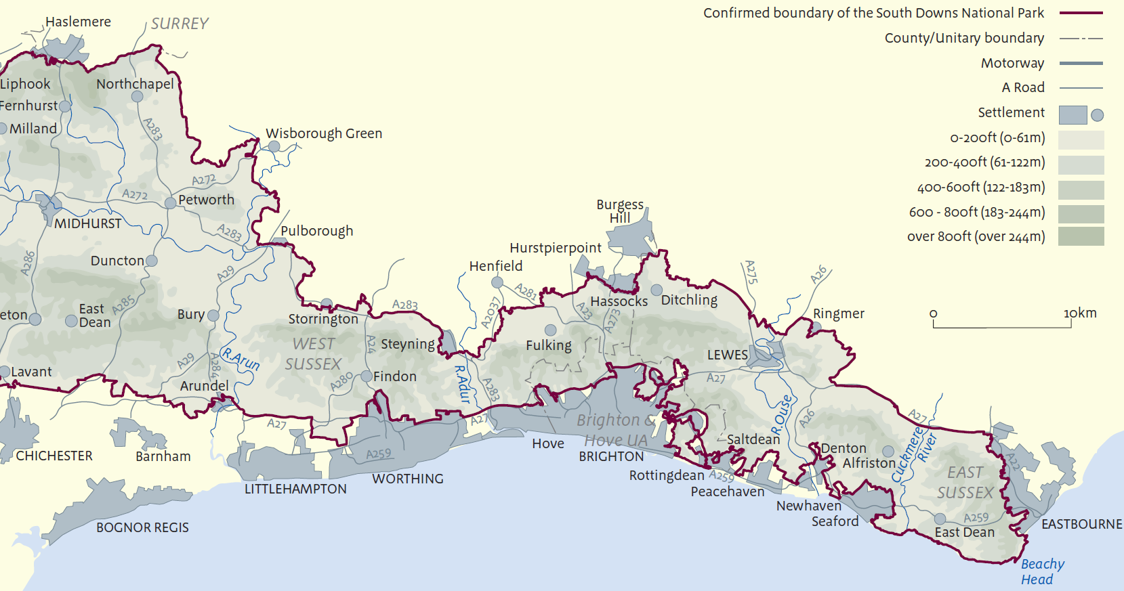
South Downs National Park

Slide 16
UK Government Vision and Circular for English National Parks and the Broads 2010 states:
‘there is a strong presumption against any significant road widening or the building of new roads through a Park, unless it can be shown there are compelling reasons for the new or enhanced capacity and with any benefits outweighing the costs very significantly. Any investment in trunk roads should be directed to developing routes for long distance traffic which avoid the Parks.’

